Slide 1
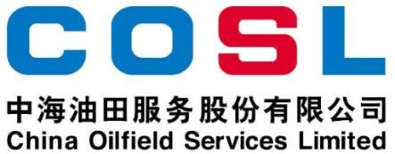
Technical Data Sheet
HIGH-PERFORMANCE LUBRICANT
Date issued： 2024-6-10
PF-EXLUBE
PF-EXLUBE is a high performance lubricant designed to decrease the coefficient , torque and drag in water-based drilling fluids when drilling highly deviated and horizontal wells. PF- EXLUBE performances excellent in saturated sodium chloride, or saturated potassium chloride, or saturated sodium formate, or saturated potassium formate.
FEATURES
Improve the lubrication performance of WBM
Reduce torque and drag in extreme conditions, especially for long extended reach drilling
Decrease the potential of differential sticking
Effective in the salt saturated environment
Do not increase rheology or gel strengths
APPLICATION
Applied in highly deviated and horizontal wells
Suitable for salty water drilling fluid, drilling-in fluids
Applicable temperature: ≤300℉ (150℃)
Recommended dosage: 3.5-7.0ppb (10-20kg/m³)
Specification
Appearance | Yellow liquid
Density，g/cm³ | 0.90±0.05
Flash point, ℃ | ≥150
Freezing point, ℃ | ≤-15
PACKAGE & STORAGE
Specifications of packaging: Plastic bucket or as per client’s requirements
Packing size: 200L/bucket or as per client’s requirements
Storage conditions:Store in dry area. Avoid open flame, strong oxidant, high-temperature environment
www.cosl.com.cn
This information is supplied solely for informational purposes and COSL makes no guarantees or warranties, either expressed or implied, with respect to the accuracy and use of this data. All product warranties and guarantees shall be governed by the Standard Terms of Sale.
Nothing in this document is legal advice or is a substitute for competent legal advice.
China Oilfield Services Limited
No.81, Xinggong West Street, Yanjiao,
Sanhe, Hebei, China
zhangxd11@cosl.com.cn
+86-10-8452 2344

