Slide 1

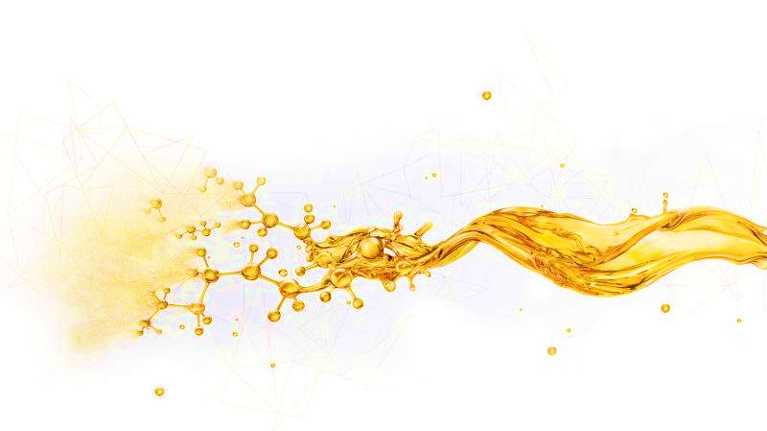
PE-ZN22S
Coagulant
Descriptions
PE-ZN22S molecular chain contains a certain number of polar groups, which can absorb solid particles suspended in water to form large flocs and accelerate flocculation.
Features
Fast solid-liquid separation
Simple and safe operation
Non-corrosive and non-irritating
Environmental friendly
Applications
Used in conjunction with flocculants, suitable for completion fluids
Recommended dosage：0.001～0.01 kg/m³
Packaging, storage and transportation
Packaging requirements: composite packaging bags or according to user requirements
Packing specification: 25 kg/bag or according to user requirements
Storage conditions: Store in a dry and ventilated place, away from heat and fire sources
Shelf life: 24 months
Physical and chemical properties
Item | Parameters
Exterior | White granular
Density（20±2℃），g/cm³ | 0.65～0.70
Solubility | Dissolved in water
pH | 6.5～7.5
This information is supplied solely for informational purposes and COSL makes no guarantees or warranties, either expressed or implied, with respect to the accuracy and use of this data. All product warranties and guarantees shall be governed by the Standard Terms of Sale. Nothing in this document is legal advice or is a substitute for competent legal advice.
www.cosl.com.cn
China Oilfield Services Limited
No.81, Xinggong West Street, Yanjiao, Sanhe, Hebei, China
Notes:
1

